Slide 1


ECEN 404 Final Presentation Team 65: Solar Playground with Security System
Team Members: Zayan Prasla, Alex Allahar, Jackson Kitchel, Victor Igbokwe Sponsor: Wonhyeok Jang TA: Zian Wang

Slide 2

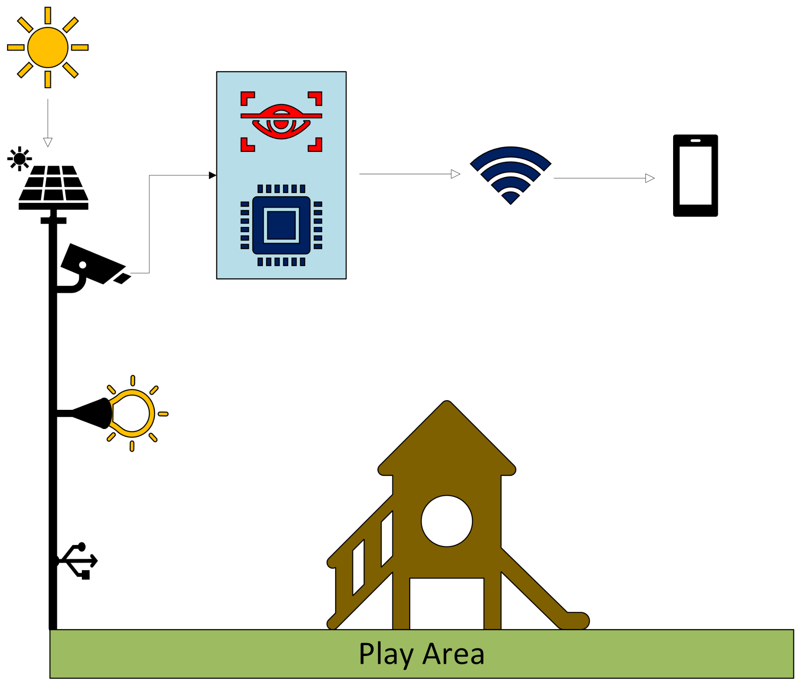
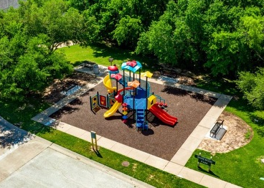
Problem Overview
A solar-powered security system with a motion-detecting camera. This system provides near real-time video feeds and sends automated alerts for suspicious activity through a mobile app, enhancing safety in these areas. It solves the problem of unreliable surveillance in remote or off-grid locations by offering an autonomous, low-maintenance solution.

Slide 3
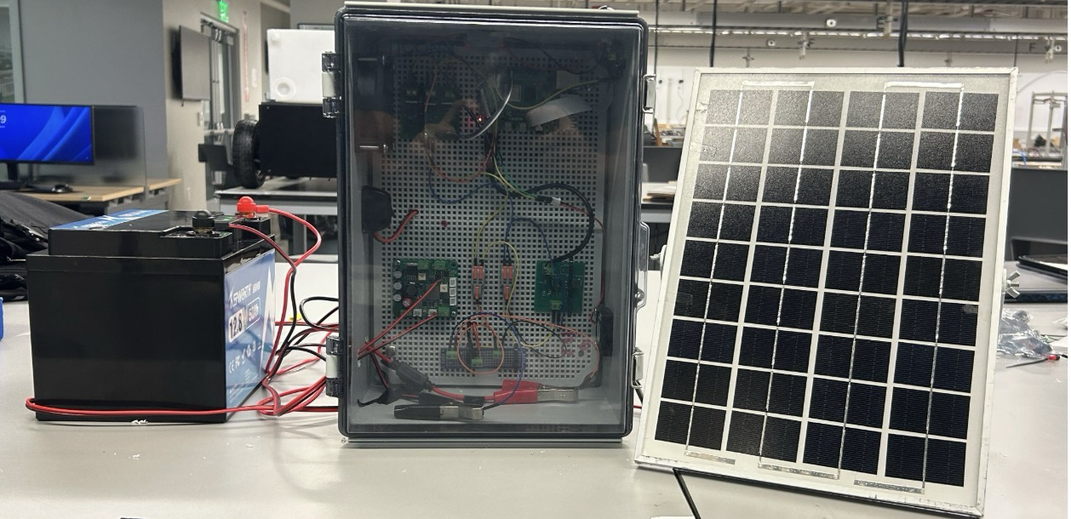
Integrated Project Diagram
Figure 1: Full System Overview
Notes:
Picture (or collection of pictures) or drawing of system
Major components labeled
Show how user connects (ui screens, pictures, etc)
Label major connections/interfaces

Slide 4
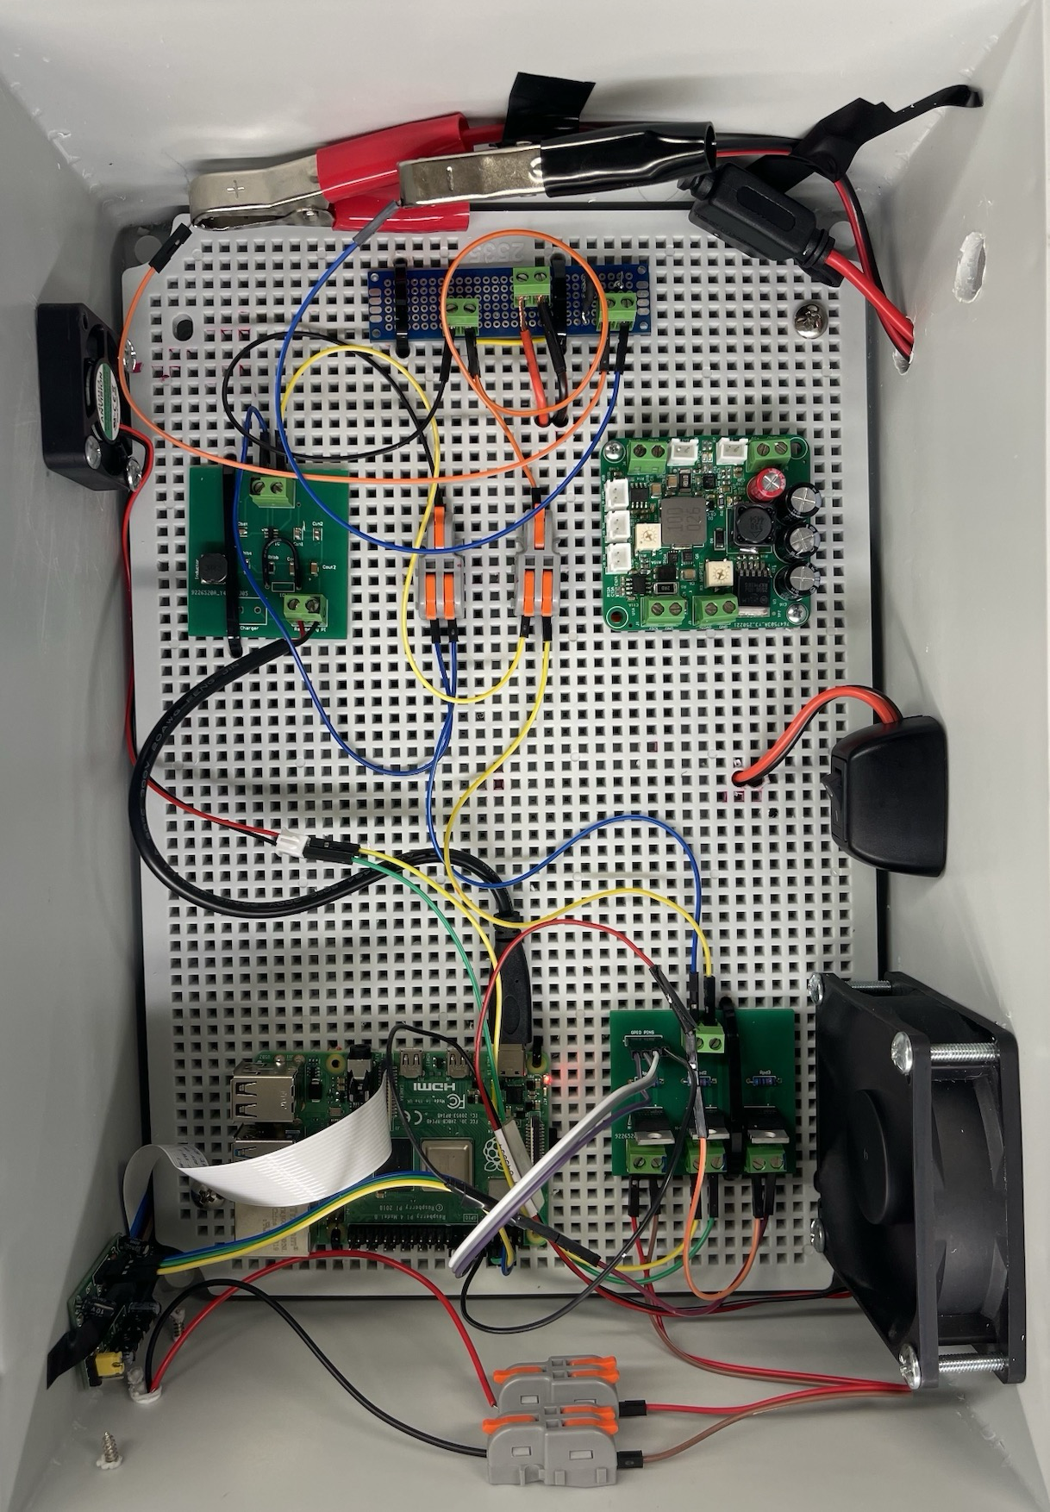
Integrated Project Diagram (Hardware)
Intake Fan
Solar Charging PCB
Buck Converter PCB
Power Switch
Relay control PCB
Raspberry Pi 4 B
CSI Pi Camera
PIR Sensor
Exhaust Fan
Figure 2: Hardware Overview
Notes:
Picture (or collection of pictures) or drawing of system
Major components labeled
Show how user connects (ui screens, pictures, etc)
Label major connections/interfaces

Slide 5
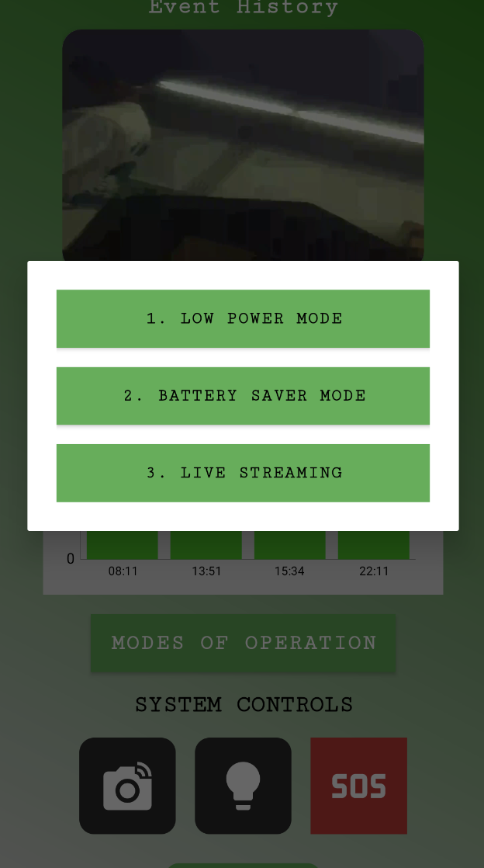
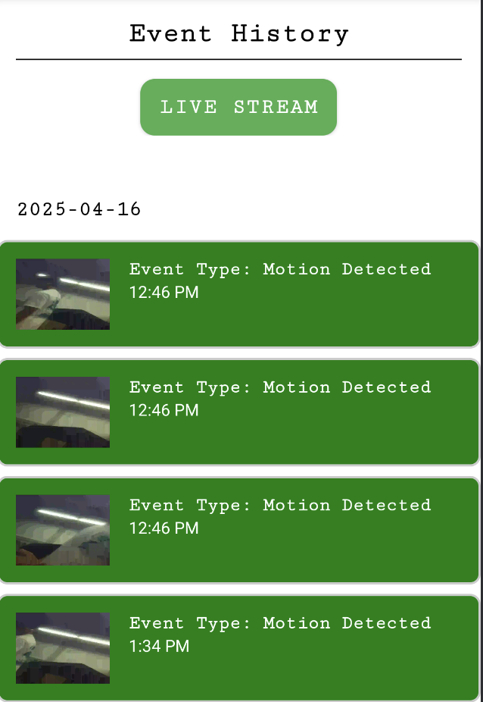
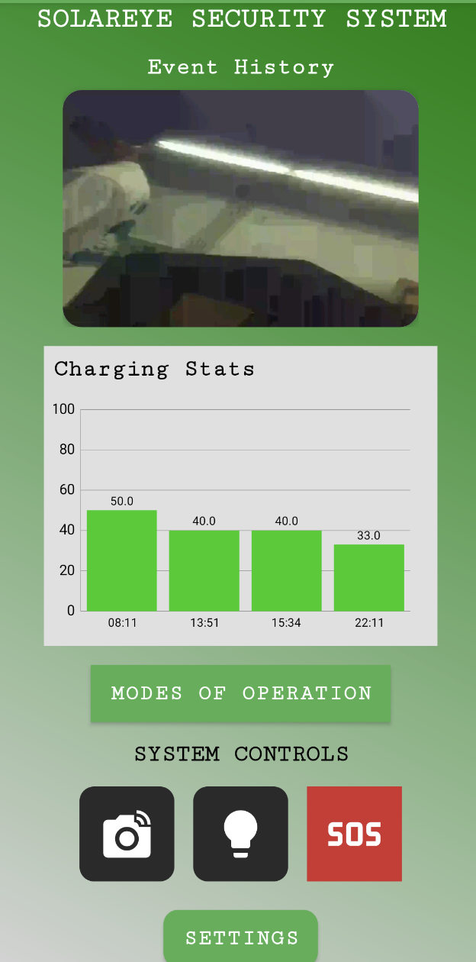
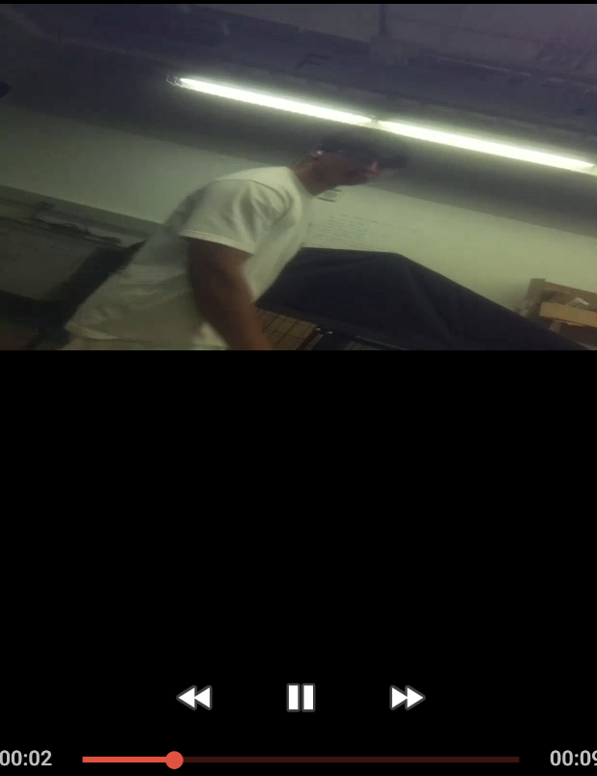
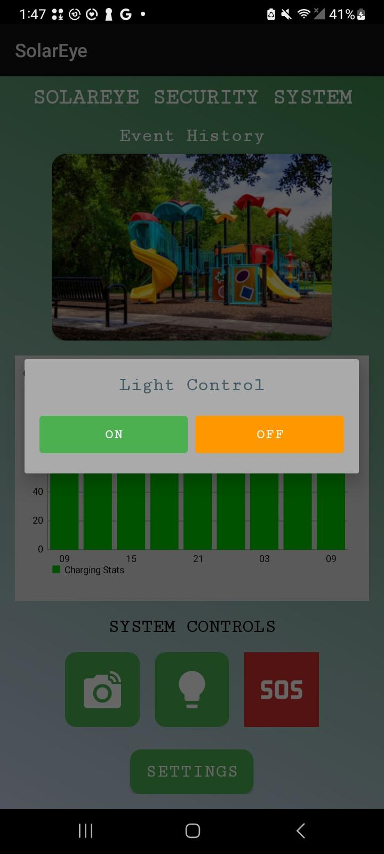

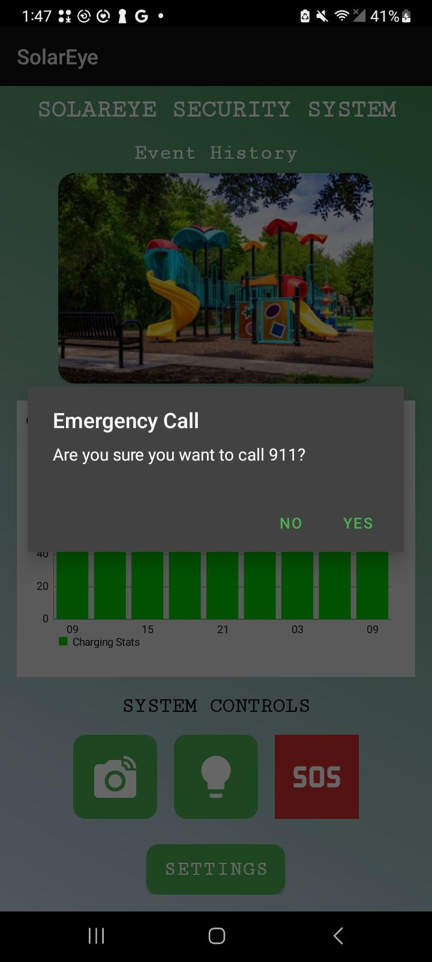
Integrated System Diagram (Software)
Figure 3: Homepage with updating Event thumbnail and updating Charging Statistics
Figure 4: Event History Page with live stream capability and playable videos
Figure 6: Modes of Operation and System Controls with successful communication
Figure 5: Video Player from the app

Slide 6
Power Generation - Jackson Kitchel
Designed & Built:
Designed and built a charging circuit capable of charging a 12V battery using a 100W solar panel.
Implemented Maximum Power Point Tracking (MPPT) using the BQ24650 IC chip
Implemented 2 current and voltage sensors using the ACS723 IC chips along with ADC
Tested & Validated:
Charging voltage test completed along with high/low voltage cutoffs. Sensors tested with MCU. Battery life to be tested.
Challenges & Solutions:
Redesigned charging circuit to solve incorrect capacitor problem, along with making the circuit more compact.
Notes:
Flask (HTTP)
Serves web interface for live video access and control
Runs lightweight, multithreaded server for responsiveness
FFmpeg + HLS Streaming
Captures video via libcamera-vid and streams with FFmpeg
Outputs low-latency .m3u8 segments for browser playback using hls.js

Slide 7
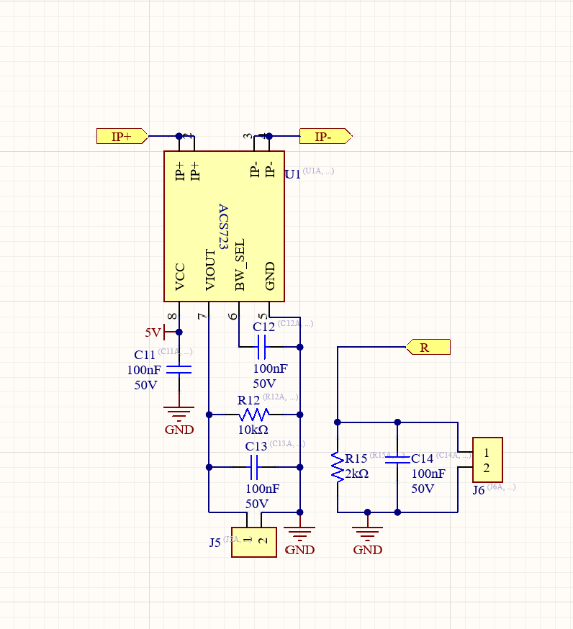
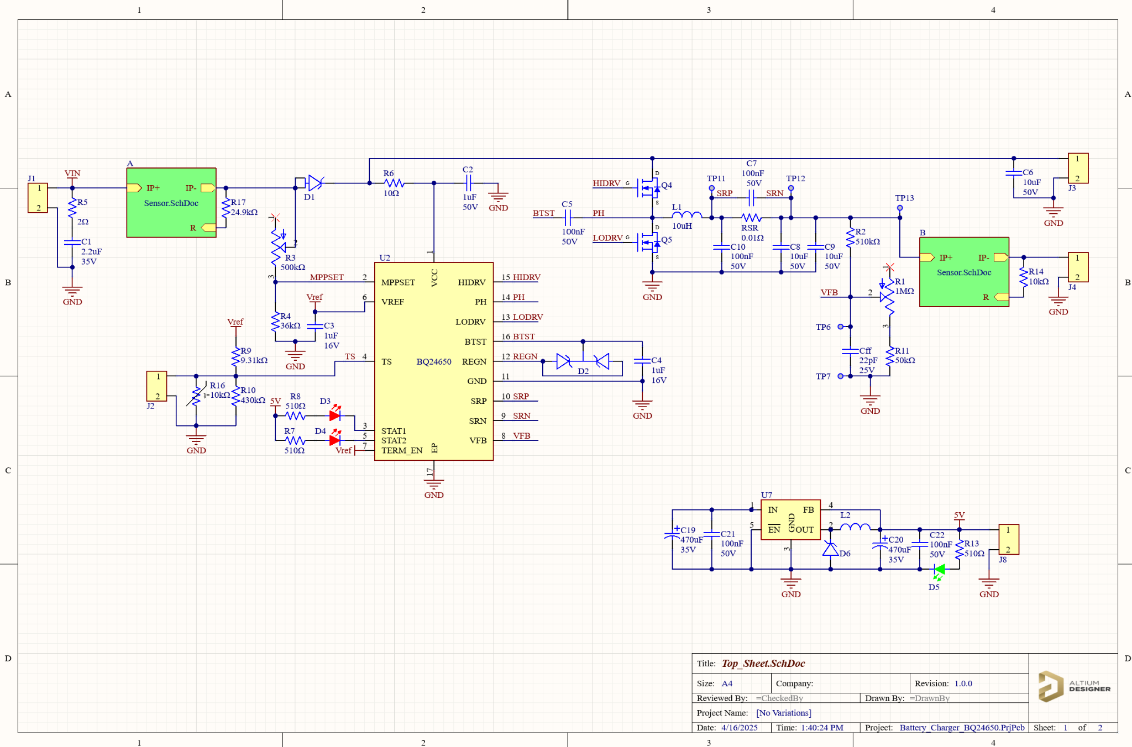
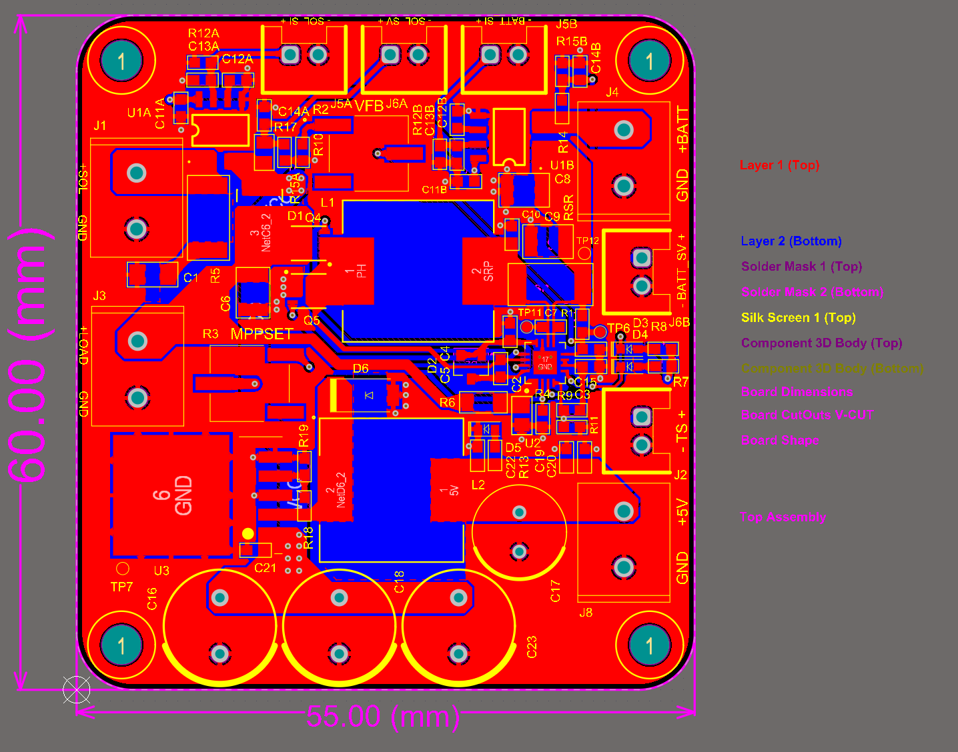
Power Generation - Jackson Kitchel
Figure 8: Current Sensor Schematics
Figure 7: Charging Circuit Schematic
Figure 9: PCB Design
Notes:
Flask (HTTP)
Serves web interface for live video access and control
Runs lightweight, multithreaded server for responsiveness
FFmpeg + HLS Streaming
Captures video via libcamera-vid and streams with FFmpeg
Outputs low-latency .m3u8 segments for browser playback using hls.js

Slide 8
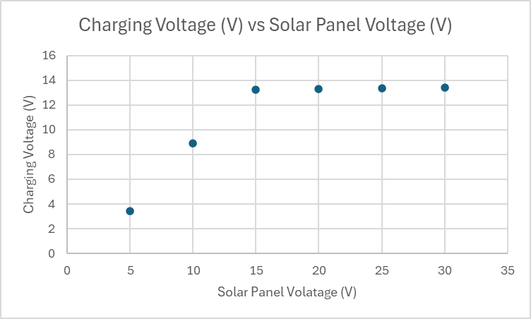
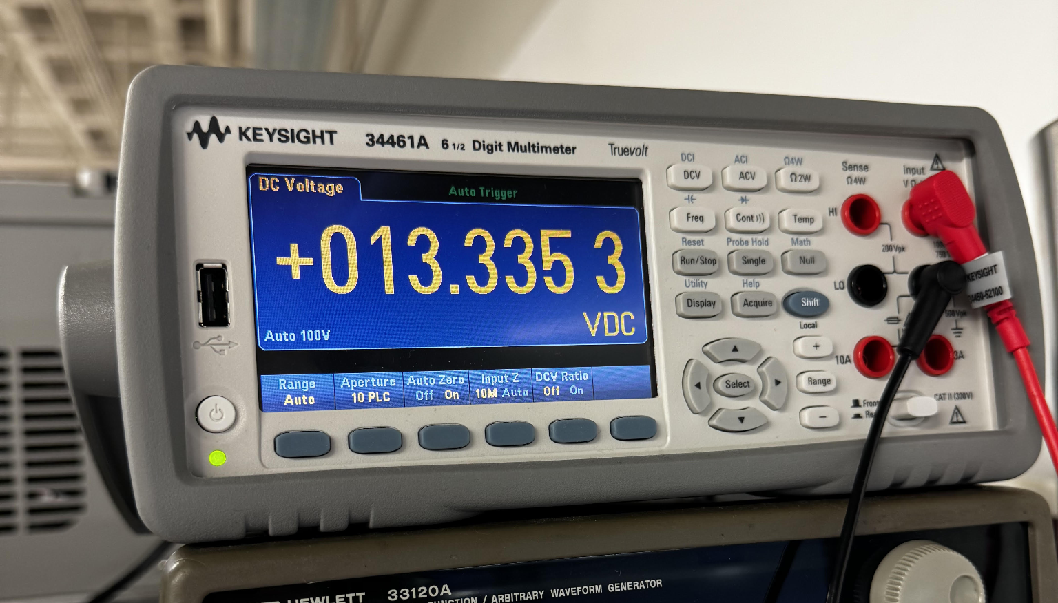
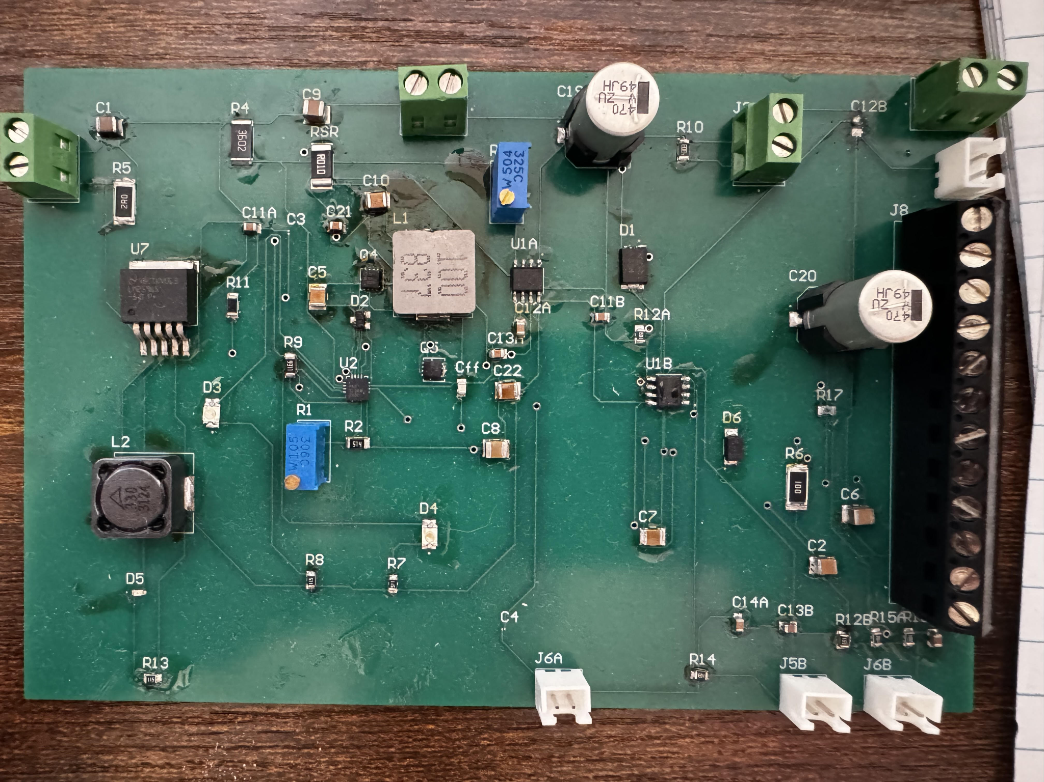
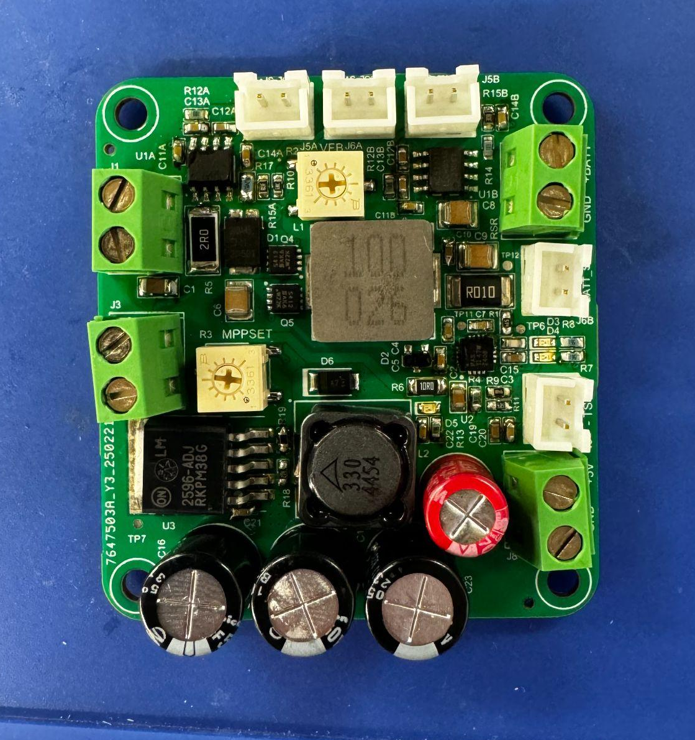
Power Generation - Jackson Kitchel
Figure 10: Charging Voltage vs Solar Panel Voltage Graph
Figure 12: Charging Voltage Output
Figure 11: Old PCB Design
Figure 13: New PCB Design
Notes:
Flask (HTTP)
Serves web interface for live video access and control
Runs lightweight, multithreaded server for responsiveness
FFmpeg + HLS Streaming
Captures video via libcamera-vid and streams with FFmpeg
Outputs low-latency .m3u8 segments for browser playback using hls.js

Slide 9
Power Distribution - Victor Igbokwe
Designed & Built:
Designed and built a buck converter using the Texas Instruments TPS563200 DCR regulator to provide stable 5V output for embedded systems.
Implemented a relay control module using an N-channel MOSFET to act as a switch, enabling the Raspberry Pi to control the on/off state of external loads.
Tested & Validated:
Buck converter Voltage and load regulation tests, Relay Control module Load regulation test, measured time delay between Pi signal and device activation.
Challenges & Solutions:
Safety for repairs: Installed a switch button to the Junction box to shut down all power flowing through the system
Buck Converter: Re-designed to ensure correct functionality
Notes:
Flask (HTTP)
Serves web interface for live video access and control
Runs lightweight, multithreaded server for responsiveness
FFmpeg + HLS Streaming
Captures video via libcamera-vid and streams with FFmpeg
Outputs low-latency .m3u8 segments for browser playback using hls.js

Slide 10
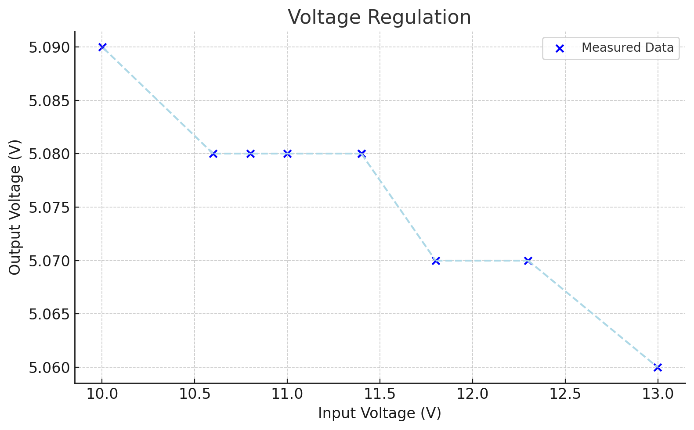
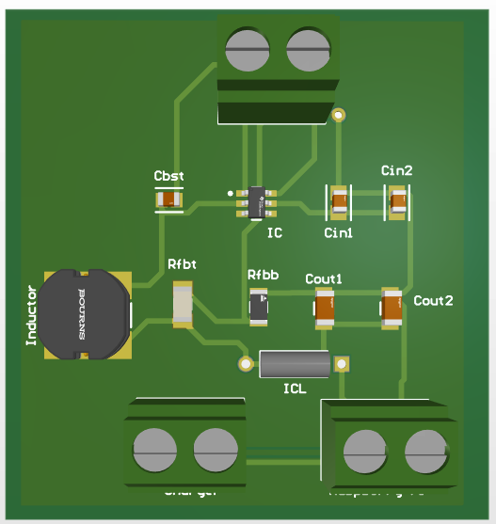
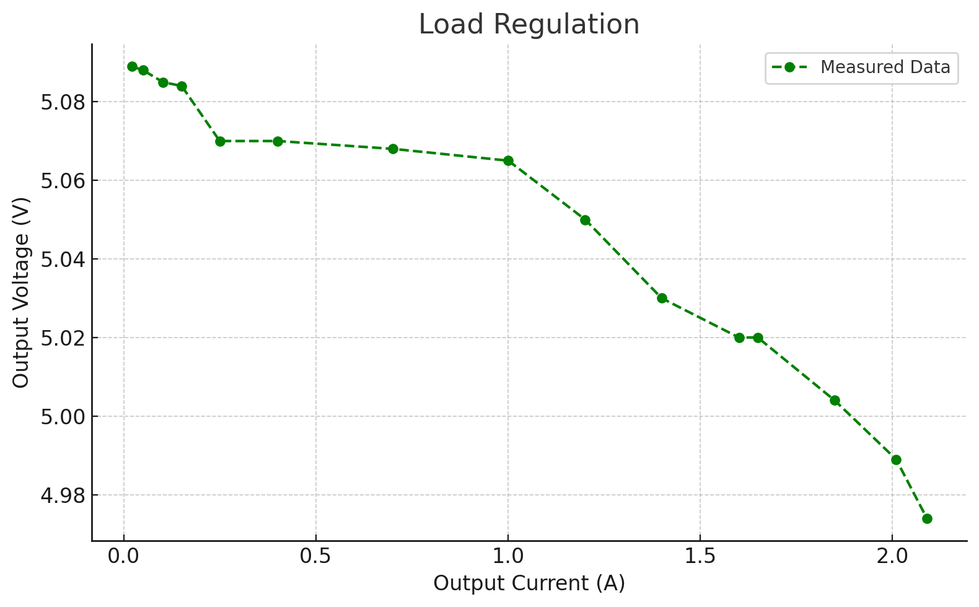
Power Distribution - Victor Igbokwe
Figure 15: Buck Converter
Figure 14: Voltage regulation graph
Initial MPU Remote Access time delay | 1.26 minutes
Raspberry PI 4B input Voltage Range(V) | 4.75 - 5.25
* 5% Tolerance
Figure 16: Load regulation graph

Slide 11
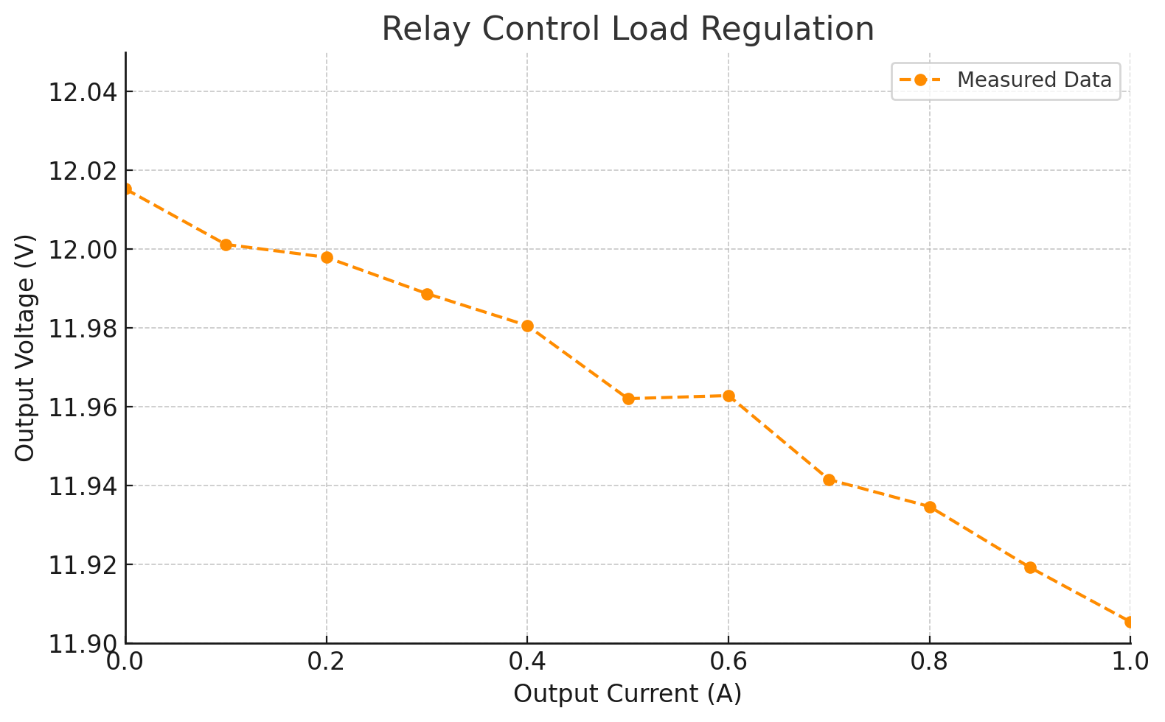
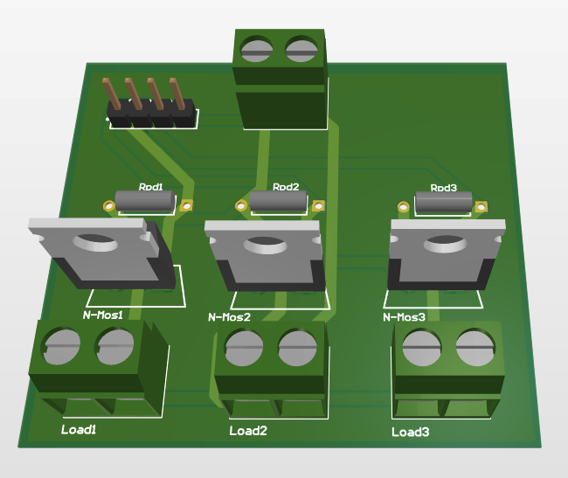
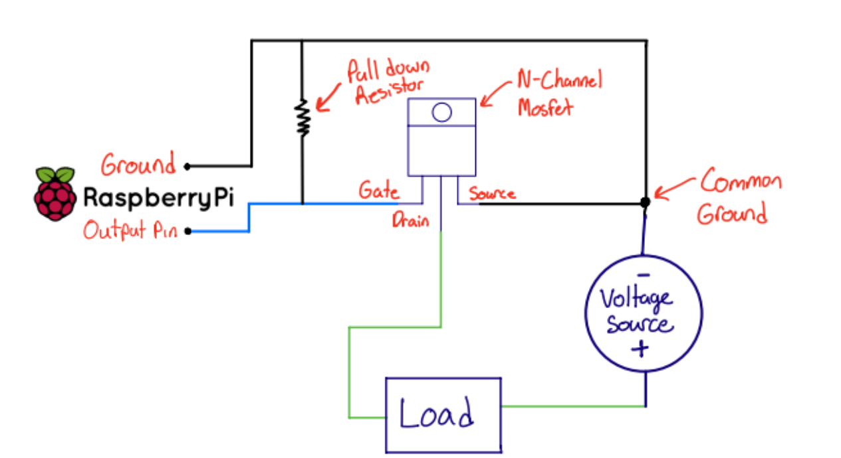
Power Distribution - Victor Igbokwe
Figure 18: Relay control module PCB
Figure 17: Relay control load regulation graph
Time delay between MPU signal and device activation
0.4 seconds
Figure 19: Use of N-Channel Mosfet diagram

Slide 12
Edge Processing Unit - Alex Allahar
Designed & Built:
Integrated PIR sensor (I2C), voltage sensor (I2C), camera (CSI), LED and fans (GPIO) with a Raspberry Pi 4B to enable the following features:
Low-Power Mode
Motion Detection
Live Streaming
LED Deterrence
Tested & Validated:
Calibrated sensors & fans, ADC communication, Camera quality, power consumption, overall hardware-software latency
Challenges & Solutions:
CPU Overload: Solved with multi-threading and modes of operation controls.
MPU Overheating: Fans for Overheating.
Camera: Replaced Camera (USB to CSI), video format selection, Live streaming delay
Notes:
Expand on the Modes of Operation Points
Livestream:
Host a Flask Server with HTTP web interface for live video access and control
Captures video and streams with FFmpeg with HLS browser playback for viewing via the HTTP Flask Url

Slide 13
Edge Processing Unit - Alex Allahar
Requirements | Target | Measured | Status
Motion to App Delay | < 1 s | 0.0784 s | Passed
Video Upload Latency | < 3 s | 1.2951 s | Passed
Real Event vs. Video Capture Ending | < 5 s | 4.03 s | Passed
Livestream Delay | < 5 s | ~7.8 s | Failed
Motion Detection Range | 12 ft | 16 ft | Passed
Fans Power Consumption | < 5 W | 8.8 W | Failed
Pi Power Consumption (Low Power) | < 20 W | 9.4 W | Passed
Pi Power Consumption (Default) | < 20 W | 10.75 W | Passed
Pi Power Consumption (Livestream) | < 20 W | 18.25 W | Passed
Figure 20: Requirements Validation Table
Notes:
Validation Meaning:
System provides near real-time motion detection to alert system with minimal latency
The biggest downside to the user experience is the Live Streaming delay
The power consumption of all three modes of operation are less that 20 W, this target was chosen due the battery specs if less that 20 W are at max constant use for a given mode of operation the system in theory should be able to run for 25 hrs on the battery ensure that it can survive the night while the panel is unable to charge.
Power consumption was calculated by measuring the current of the system under load in Lab.

Slide 14
Android Application - Zayan Prasla
Designed & Built:
Created a secure Firebase Authentication system for account creation, email verification, password reset, password policy and persistent login
Developed camera, LED, and SOS control features, with Modes of Operation for system power usage
Implemented real-time event history with video thumbnail previews and video playback
Tested & Validated:
Verified user authentication flows, password policies, and email verification timeouts
Confirmed Firestore integration for reading and writing system control states
Ensured proper display and playback of video thumbnails from Firestore Database URLs
Challenges & Solutions:
Firestore path issues: Fixed with proper document structure and logging
Video Player issues: Solved by having the mcu create video url links for the app to open from Firestore Database.

Slide 15
Android Application - Zayan Prasla
App Features Validation Table:
Requirements | Spec | Measured
Authentication Timeout | Email verification link expires in 5 min | Verified expiration at ~5:01 min
Password policy enforcement | Min 6 char, 1 capital, 1 symbol, 1 number | 100% rejection rate on invalid attempts
Video event thumbnail loading | Thumbnail shown within 2 sec | Avg load time: 1.2 sec, max: 1.8 sec
Battery graph recency | Only last 24h voltage data shown | Consistently accurate range filter applied
Mode change response (Firestore write) | Update reflected in < 1.5 sec | Avg: 0.9 sec, Min: 0.6 sec, Max: 1.4 s
Figure 21: App Features Validation Table:

Slide 16
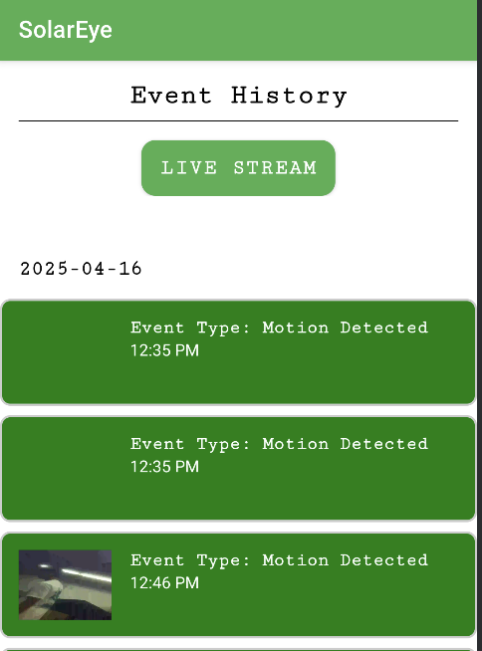
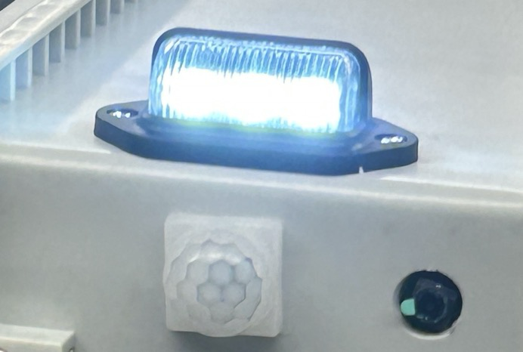
Integrated System Results
End-to-End System Operation (Low Power):
Low Power Mode Predicted Run Time ≈ 32.8 hours
Lower Power Mode (User Experience):
Able to see when the event occurred, and duration via but no video.
LED Deterrence is available, flashes the LED rapidly.
Figure 22: LED Deterrence Active
Figure 23: Event History
Notes:
This section shows end-to-end system operation
Show and provide details on a few important end-to-end use scenarios that you developed and validated. Giving results (be quantitative here – results for key performance indicators … time to complete task, overall accuracy of task, success/fail measures)
About 2 minutes total
The run time is calculated given the power consumption of Pi combined with power consumption of Fans

Slide 17
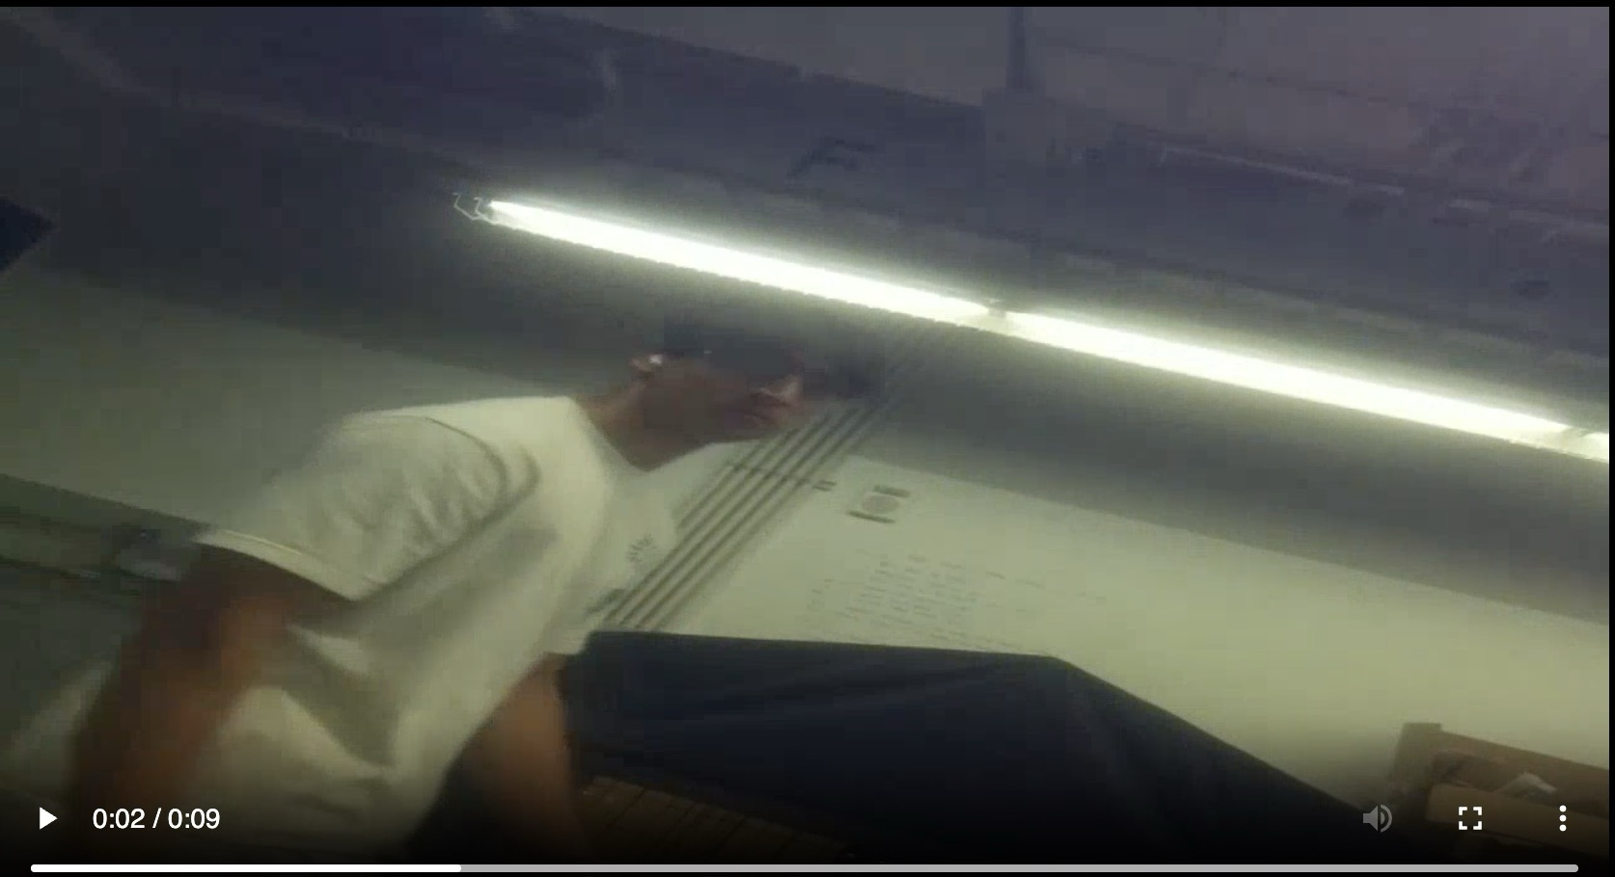
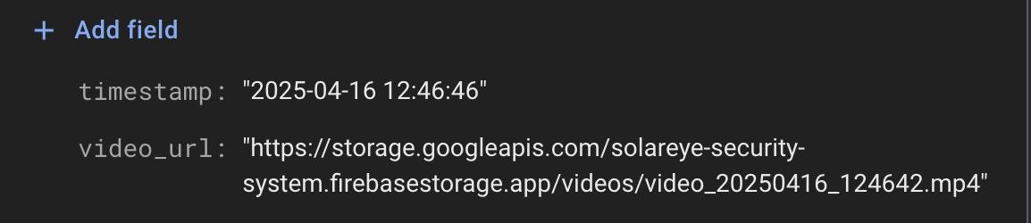
Integrated System Results
End-to-End System Operation (Default):
Motion Detection Mode Predicted Run Time ≈ 30.69 hours
Motion Detection Mode (Pipeline):
PIR Sensor detects motion → event is logged → camera starts recording → recording stops after 2 seconds of no motion → video saved locally(h264) → uploaded to Firebase(mp4) → app receives video with timestamp → user views it in event history.
Figure 25: Notification Packaged for App
Figure 24: Motion Detection Capture
Figure 26: Event History
Notes:
This section shows end-to-end system operation
Show and provide details on a few important end-to-end use scenarios that you developed and validated. Giving results (be quantitative here – results for key performance indicators … time to complete task, overall accuracy of task, success/fail measures)
If Low Power Mode or Livestreaming are triggered by the user, motion detection will be active.
About 2 minutes total
The total Run Time is calculated by combine hardware component power consumption and Pi power consumption given the 50Ah 12V battery

Slide 18
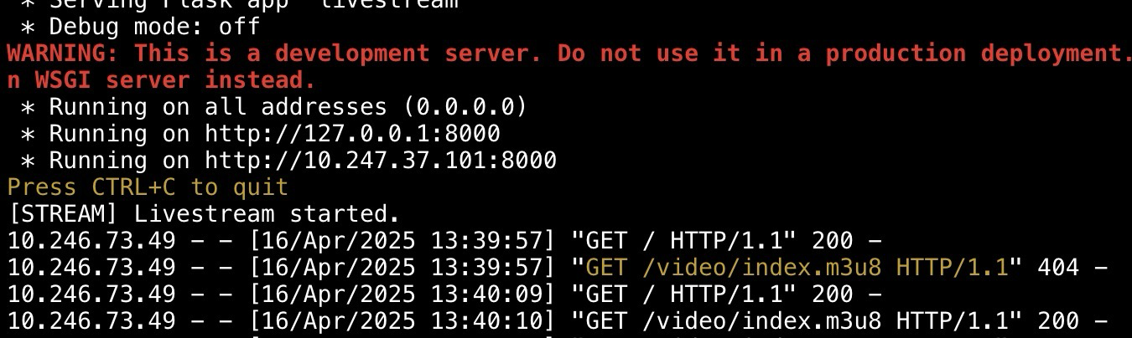
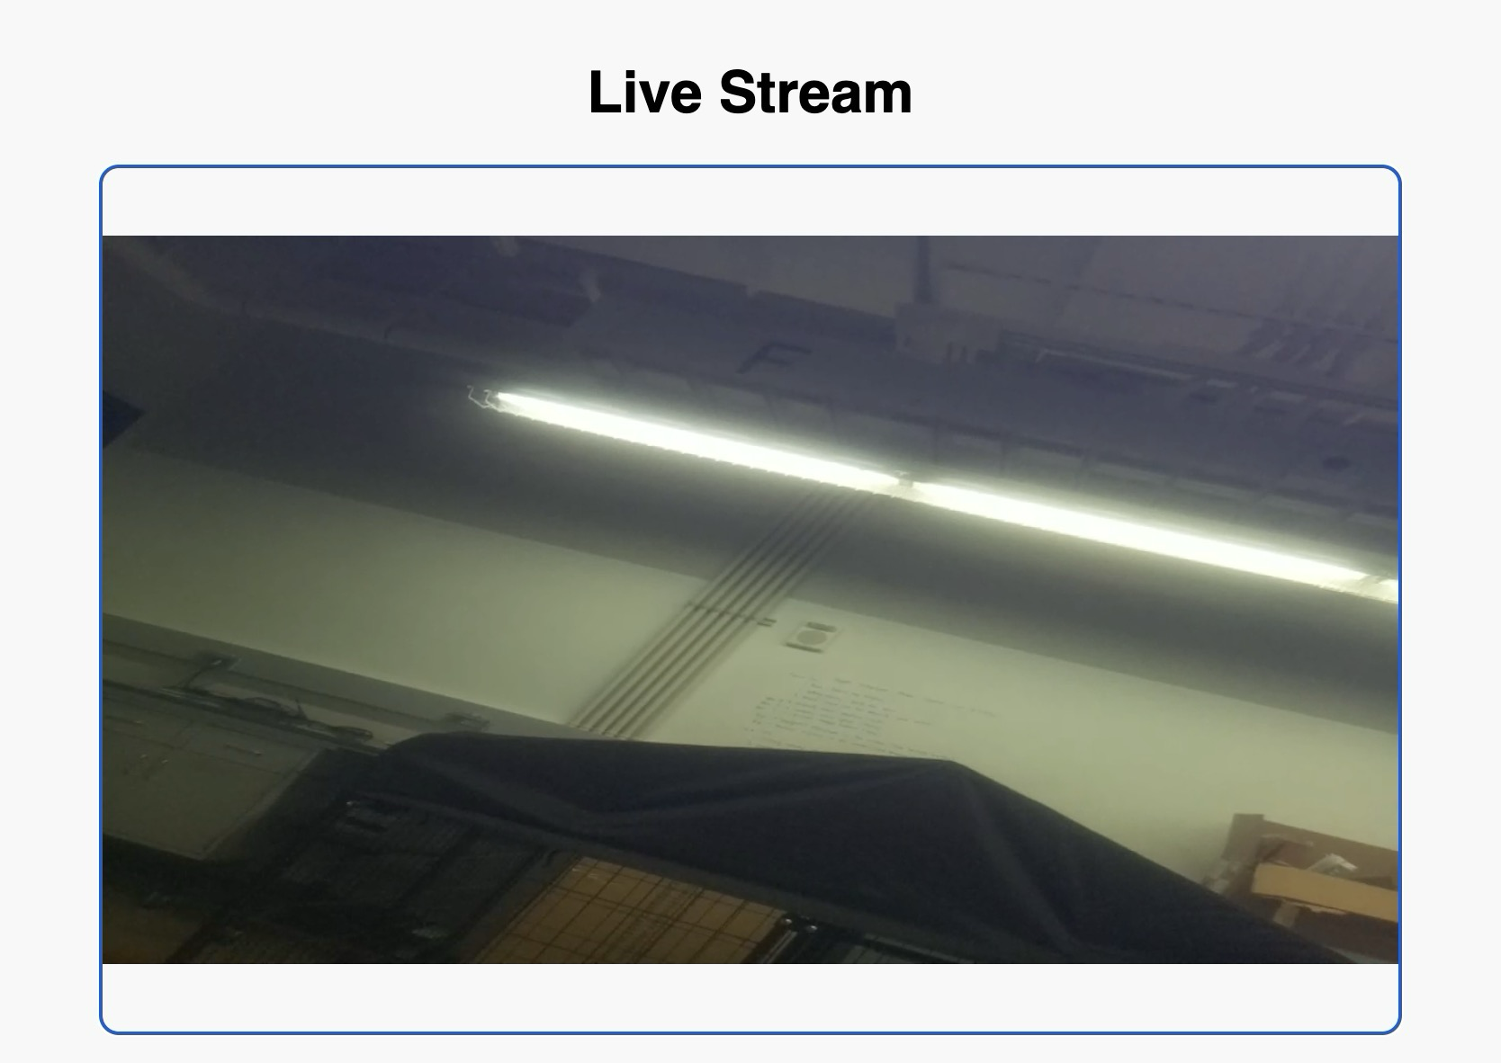
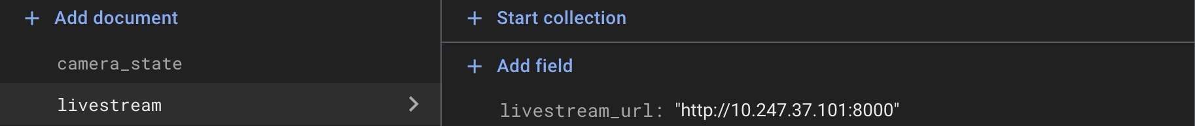
Integrated System Results
End-to-End System Operation (Livestream):
Livestream Mode Predicted Run Time ≈ 22.18 hours
Lower Power Mode (User Experience):
User click Livestream Button - HTTP Server Activates - Pi starts HLS Stream Protocol - Stream HTTP Link create/sent to app - user can access stream by clicking on the Link
Figure 25: LIvestream HTTP Server Startup
Figure 26: LIvestream HTTP Link to Firebase
Figure 27: LIvestream UI
Notes:
This section shows end-to-end system operation
Show and provide details on a few important end-to-end use scenarios that you developed and validated. Giving results (be quantitative here – results for key performance indicators … time to complete task, overall accuracy of task, success/fail measures)
About 2 minutes total
Livestream:
Host a Flask Server with HTTP web interface for live video access and control
Captures video and streams with FFmpeg with HLS browser playback for viewing via the HTTP Flask Url

Slide 19
Conclusions
Changes from original System design:
Buck Converter IC chip change leading to re-design of Buck converter
Relay control module PCB added to system design
Charging Circuit redesigned to solve capacitor problem and consolidate PCB
ADC added to system to allow communication between current sensor IC chips and MCU
Current Status:
Integration Complete
Operational Testing Complete
Validation Complete
Edge Case Testing in Progress
Notes:
List issues encountered that required changes from system described in Conops, FSR/ICD and resulting system design changes
Current status (eg. integration/test/validation complete; Integration complete, but BT comm not fully validated; Repeating testing for replacement PCB, integration/validation to be completed in 1 week)

